Slide 1
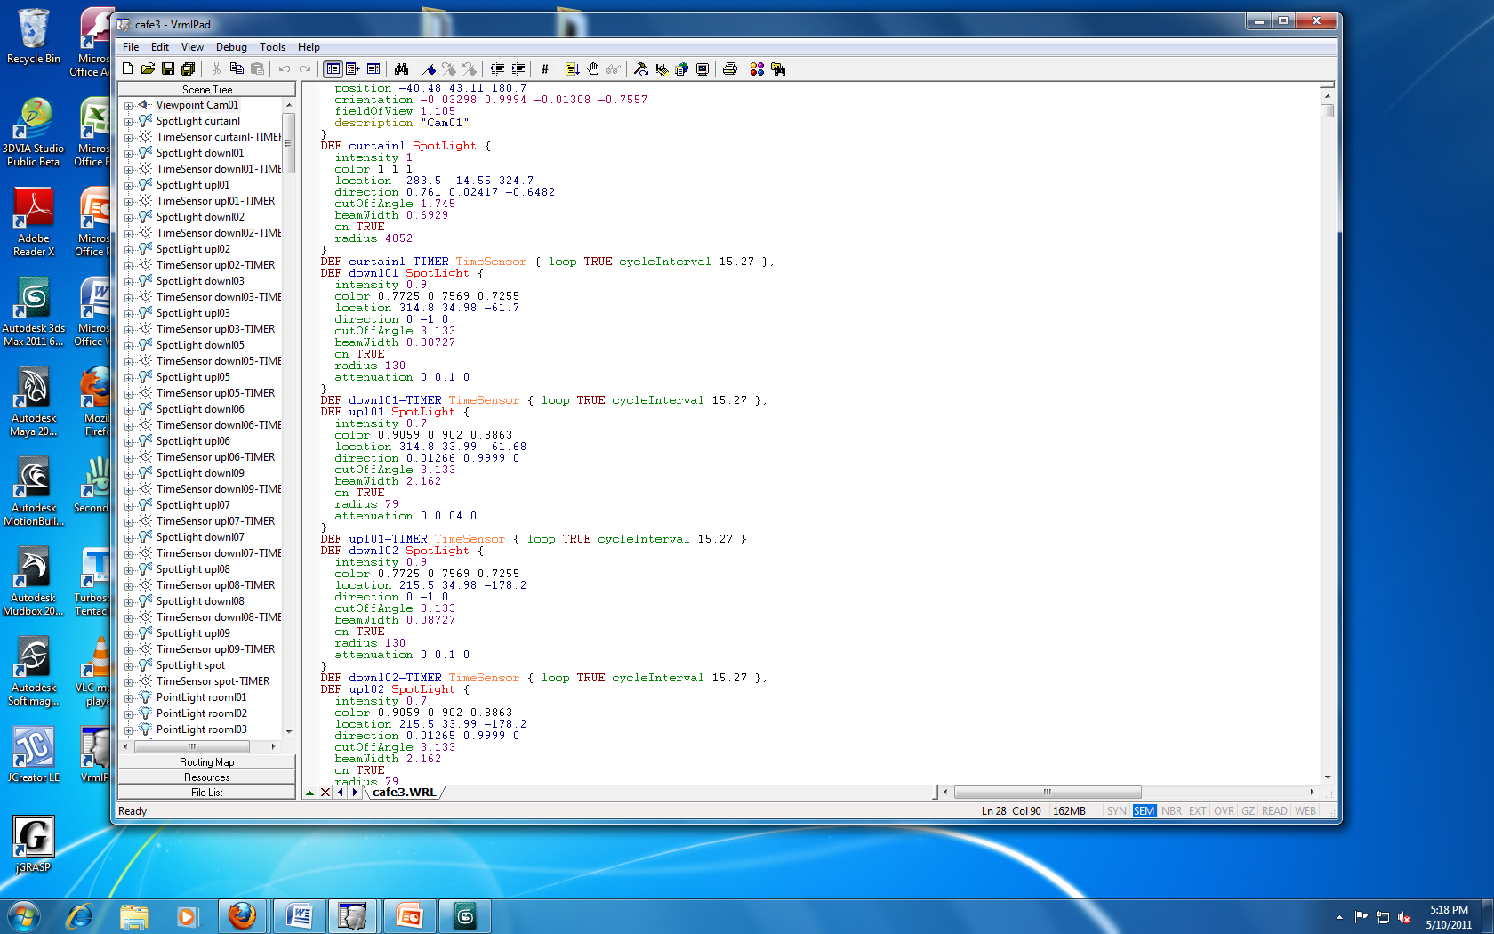

Slide 2
VRML Coding
Screen shot of Touch, Time, and Proximity Sensor code in VRML Pad.
Screen shot also includes coding for different view points and lighting used in 3ds max. (Point Light node, Spot Light node, and Directional Light)

